Slide 1
Making the Most
of Year 7
September 2025

Slide 2
The aims of this presentation
To give you an overview of:
  Key contacts and roles
  School Day, Curriculum, Clubs and Homework
  Communication
  Uniform, Phones and Conduct
  Assessment and Progress Measures
  Supporting your child at home
  Key Dates
  Enrichment Days
  Introduction to Denbigh Association

Slide 3
Key Contacts & Roles

Slide 4
Key Contacts for Year 7
Head of Year 7 Pastoral Leader
Miss Roche
Head of Year 7 Transition Lead
Mrs Smulders
Assistant Headteacher for
Progress and Achievement (Years 7-10)
Mr Waters
Notes:
Define Pastoral vs Progress, Explain partnership

Slide 5
Contact Emails
Tutor Group | Member of staff | Email address
7GD | Mrs Davies-Fairclough | daviesg@denbigh.net
7SB | Miss Burlace | burlaces@denbigh.net
7SD | Mr Dean | deans@denbigh.net
7MT | Miss Tarazona Bosch | tarazonaboschm@denbigh.net
7KD | Miss Dilley Miss Williams | dilleyk@denbigh.net williamsh@denbigh.net
7RN | Mrs Nixon | nixonr@denbigh.net
7SS | Mr Szeto | szetos@denbigh.net
7VN | Mrs Skantharajan | skantharajanv@denbigh.net
7LP | Miss Pretorius | pretoriusl@denbigh.net
7MS | Mr Stott | stottm@denbigh.net

Slide 6
Other Useful Emails
Role | Member of Staff | Email
Head of Year 7 Pastoral | Miss Roche | rochee@denbigh.net
Head of Year 7 Transition Lead | Mrs Smulders | smuldersp@denbigh.net
Assistant Headteacher Progress and Achievement Years 7-10 | Mr J Waters | watersj@denbigh.net
SENDCO | Mrs Martin | martinr@denbigh.net
Pupil Premium Champion | Mrs G Molloy | molloyg@denbigh.net
Attendance/ Lead Attendance Officer | Mrs Arnold Miss Blackall | studentabsences@denbigh.net

Slide 7
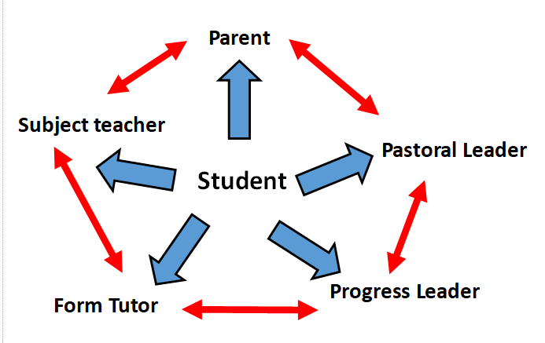
Working Together
Pastoral: Focus on wellbeing and behaviour
Transition Lead
Notes:
Positive focus - In it together

Slide 8
Role of the Tutor
Daily point of contact
Advocate in school
Mentoring
Supporting anxiety and stress
Helping to develop motivation
Looking at goals and career pathways
Supporting planning and organisation
Sharing a variety of revision techniques
Delivers PSHE lessons weekly in tutorial

Slide 9
Role of Parents/Carers
Parental support is eight times more important in determining a child’s academic success than social class.
The Campaign for Learning found that parental involvement in a child’s education can mean the difference between a high grade at GCSE and a much lower grade.
Support students by ensuring they have the correct equipment and a good routine.
Attend meetings e.g. tutor/subject consultation evenings.
Check ClassCharts app and discuss achievement/behaviour.
Follow what students are studying by looking on our website curriculum area.
Encourage and support extra-curricular activities.
Contact tutor/HOYs with queries or concerns.
Notes:
Be positive together

Slide 10
Role of the Student
Accept responsibility for your own learning
Be engaged and motivated
Speak to the teacher if you do not understand
Complete all classwork and homework
Stay positive
Get involved in as much as possible
Follow the Denbigh Values

Slide 11



Denbigh Values
Notes:
Your personal success
Getting the grades, you were working for/getting an apprenticeship/ getting into Sixth form / getting into college etc.

Slide 12
Working in Partnership
Headteacher bulletin
Year group newsletter
Parentmail
ClassCharts App
Headteacher/Deputy Headteacher Drop-In
School website
Email
Making the Most of Evening (8th September)
Tutor Consultation Evening (1^{tst} October)
Subject Consultation Evening (3rd June)
Denbigh Association

Slide 13
School day, Curriculum, Clubs and Homework
Notes:
PJE

Slide 14
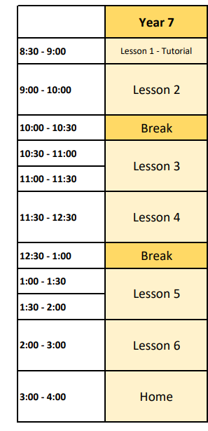
School Day
  Students to arrive between 8:15 and 8:28am
  Break at 10:00am
  Lunch at 12:30pm
Notes:
Subjects are then broken down into a weekly timetable, starting the day with tutors in tutorial each day where students also complete PSHE lessons.

Slide 15
Punctuality & Organisation
Being just a few minutes late to lessons on a regular basis can have a negative effect on learning:
3 mins late to 1 lesson per week = 117 mins
(nearly 2 missed lessons in a school year)
3 mins late to 1 lesson per day = 585 mins
(nearly 10 missed lessons or 2 school days in a school year)
3 mins late to every lesson every day = 2,925 mins
(around 49 missed lessons or 10 school days in a school year)
*If your child would like a locker please go to Parentmail – Payments & Shop tab – Select Lockers - £15 non-refundable fee
*Locker emails have now been sent to all Year 7 students who purchased one so please check these for details.

Slide 16
Our Expectations
Students are asked to…
Walk quickly and quietly during transition time
Not to treat transition time as break time
Make an excellent start to every lesson
We monitor punctuality on a weekly basis

Slide 17
Overview – Year 7 Curriculum
English 3 hours
Mathematics 3 hours
Science 3 hours
Modern Languages 3 hours
Design Technology 2 hours
Physical Education 2 hours
Computing 2 hours
Geography 1 hour
History 1 hour
Philosophy, Religion & Ethics 1 hour
Art 1 hour
Music 1 hour
Drama 1 hour
Personal Development 1 hour
Personal Development is the study of Leadership, Organisation, Resilience, Initiative and Communication Skills
Notes:
At Denbigh we continue to pride ourselves on providing both a diverse and enriching school curriculum. As you can see students explore the 14 different subjects as part of their curriculum.

Slide 18
The Curriculum
The Year Group is divided into thirds of equal ability - the X, Y and Z bands.
Students will only be set according to their ability in Maths from December.
Students remain in mixed classes, within their bands for the remaining subjects.
PE is taught in single sex groups.
*If students have PE on their timetable they are required to get changed at school, they must not wear PE kit to/from school

Slide 19
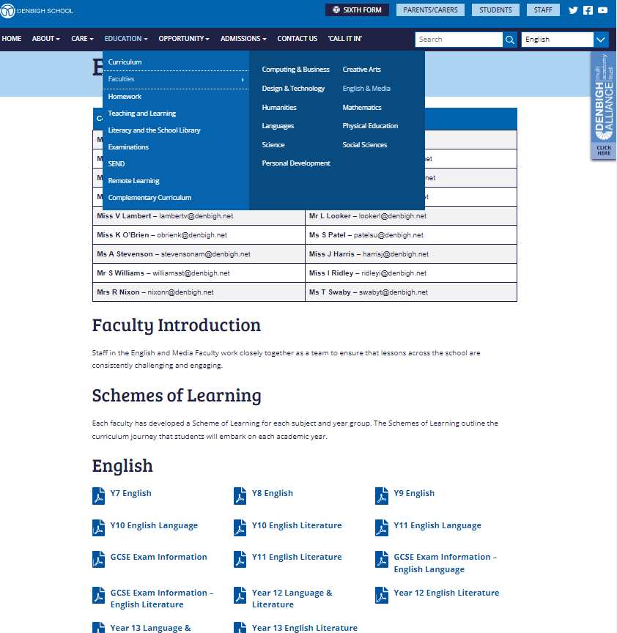
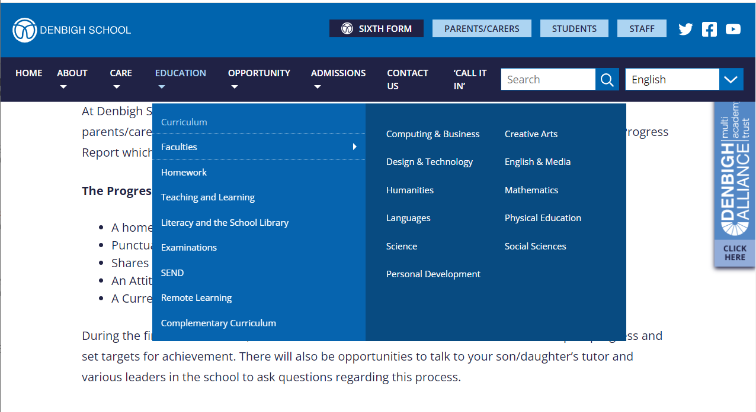
Year 7 Curriculum continued
Notes:
At Denbigh we continue to pride ourselves on providing both a diverse and enriching school curriculum. As you can see students explore the 14 different subjects as part of their curriculum.

Slide 20
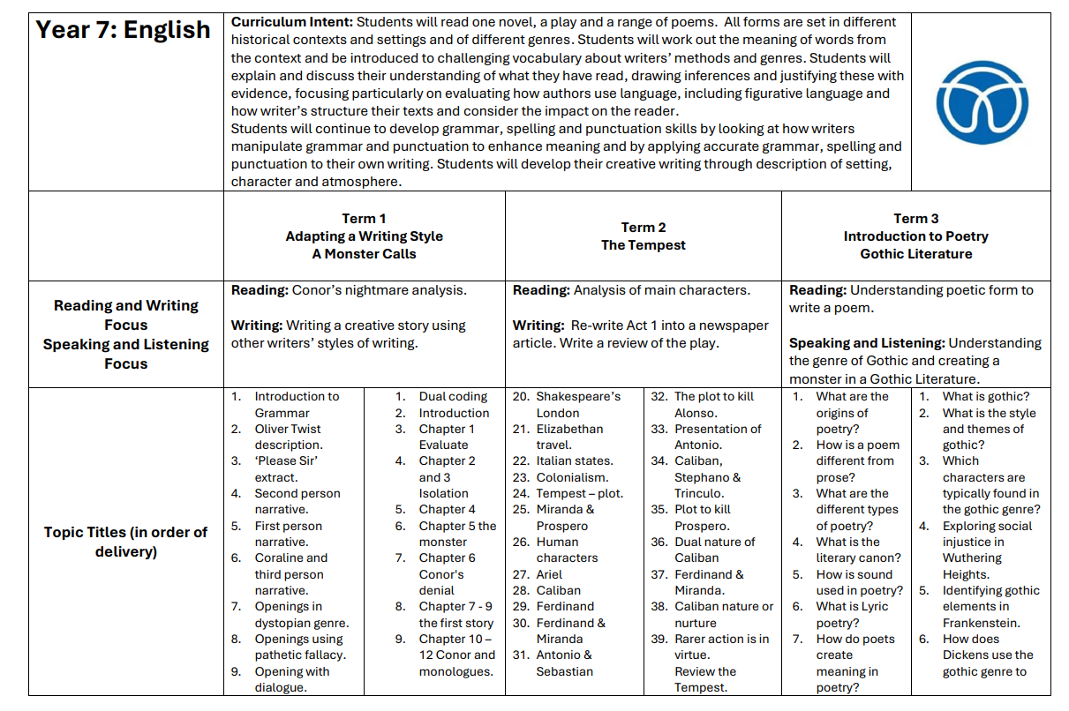
Year 7 Curriculum continued
Notes:
At Denbigh we continue to pride ourselves on providing both a diverse and enriching school curriculum. As you can see students explore the 14 different subjects as part of their curriculum.

Slide 21
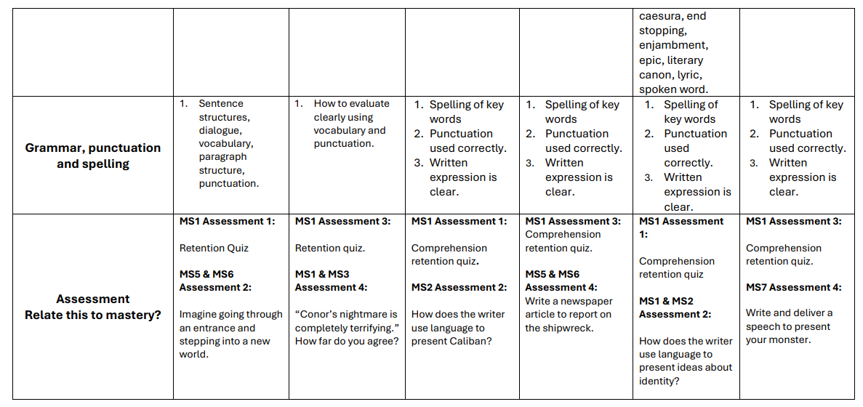
Year 7 Curriculum continued
Notes:
At Denbigh we continue to pride ourselves on providing both a diverse and enriching school curriculum. As you can see students explore the 14 different subjects as part of their curriculum.

Slide 22
Homework
Subjects | Taught Hours | Typical amount of homework set each week
English Maths Science MFL | 3 | 45
Computing Design Technology | 2 | 30
Geography History Music Drama Art | 1 | 45 mins per fortnight or 20-25 minutes a week
PE PD | 2 1 | No homework
Teachers will be using Microsoft Teams to set all student homework
Students should be checking Teams and their planner
Planners have a To-Do list to record homework
Notes:
At Denbigh School, we place great value on homework. We believe that homework helps students use and develop independent learning skills and important study habits. Following the use of Teams as part of our remote learning provision, we have made the decision that all homework is to be set through Microsoft Teams Assignments. This means that for every piece of homework set, whether completed electronically, or by the traditional means, students will receive a Teams notification on their respective subject Teams page.
A homework notification will also be created on SIMS which will then show on both the Student and Parent SIMS Apps. This will allow you to effectively monitor the setting and organising of their homework.
Should you foresee your son or daughter having issues with accessing Teams from home, please contact their tutor via email so that you can discuss a plan of action.
Our expectations are that Students must ensure that they complete homework by the date it is due in and it is their responsibility to ensure they have either submitted their homework via Teams or placed their homework into their bag. If homework is to be completed on paper, it may be beneficial for students to get themselves a homework folder so they can keep their homework sheets or books together.
If you have concerns about an aspect of the homework or homework that has been set, it is important to address this with the teacher in the first instance so that we can ensure issues can be addressed as soon as possible. It is usually best to contact the teacher by email.

Slide 23
Homework so far…
In their first Computing lesson, students will be given their log in details
All students have been issued a sticker into their planner with their login details. Once they have logged in during their Computing lesson and created their own password, they will be able to log in at home
Homework should also be written in their planner as a reminder to check teams
Notes:
At Denbigh School, we place great value on homework. We believe that homework helps students use and develop independent learning skills and important study habits.
Our expectations are that Students must ensure that they complete homework by the date it is due in and it is their responsibility to ensure they have either submitted their homework via Teams or placed their homework into their bag. If homework is to be completed on paper, it may be beneficial for students to get themselves a homework folder so they can keep their homework sheets or books together.
If you have concerns about an aspect of the homework or homework that has been set, it is important to address this with the teacher in the first instance so that we can ensure issues can be addressed as soon as possible. It is usually best to contact the teacher by email.

Slide 24
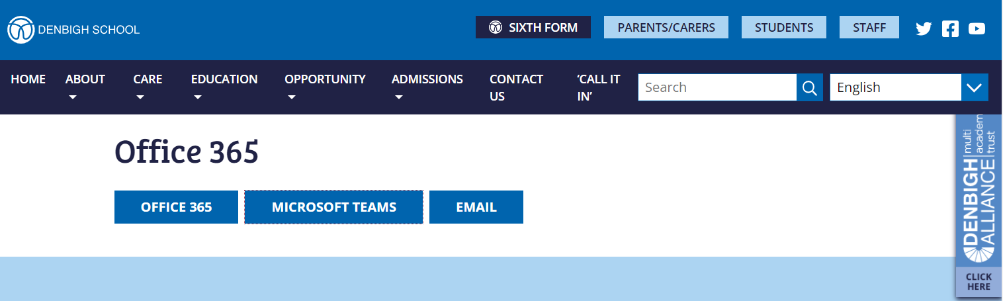
Logging in at home

Slide 25
Planners
Timetable
Key Values
Attitude to Learning
Planning for test and exams
Revision tips and planner
Wellbeing
Digital wellbeing
Reading log
Calendar
Ruler
Periodic table
UK, Europe and World Map
Whiteboard
Planners have been given out to every student.
They are expected to be put on the desk at the start of every lesson and are also used as an exercise book for tutorial

Slide 26
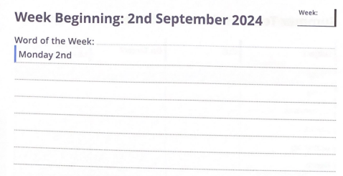
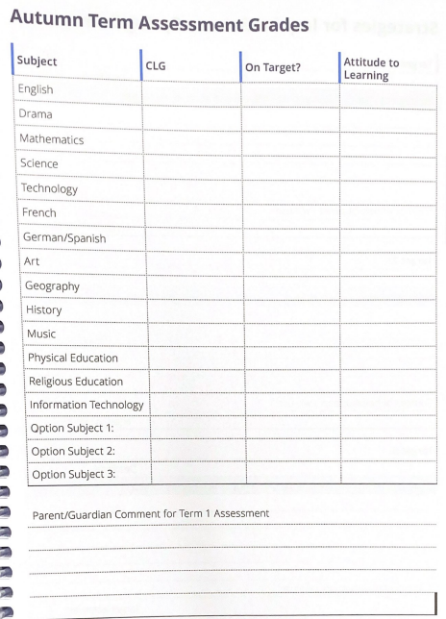
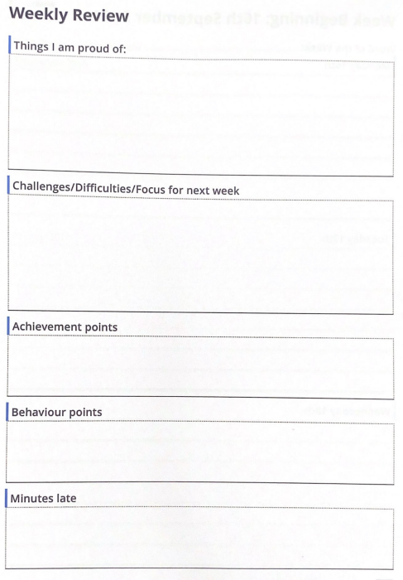
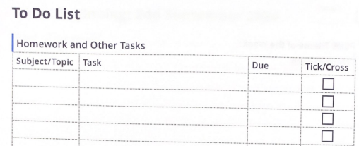
Planners are also a great starting point for you to have conversations with your child

Slide 27
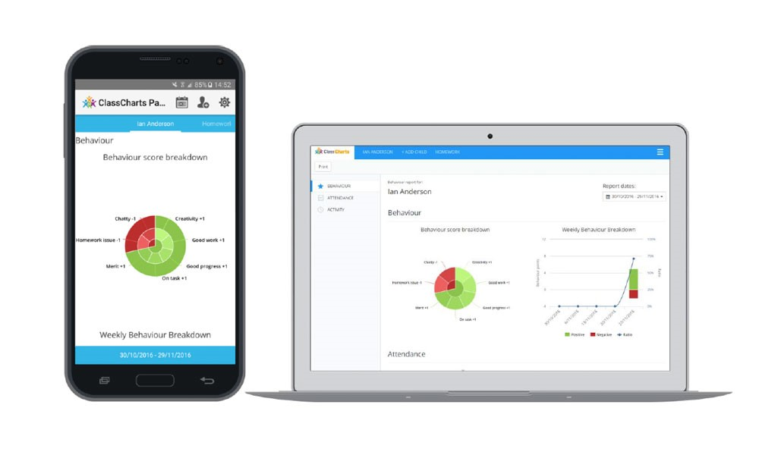
ClassCharts
Classcharts is an online system we use at Denbigh that will help give you instant access to details about your child’s progress and behaviour. Parents and students have access to ClassCharts and should use this platform for:
A more detailed insight into achievement and behaviour points. You will be able to view why points were issued and also see any awards earned by your child.
Access to the reward shop. This is a place where students can ‘spend’ their achievement points to buy rewards at designated points in the year.
The ability to view your child's timetable.
If you have any problems accessing your ClassCharts account, please email classcharts@denbigh.net
Notes:
PJE

Slide 28
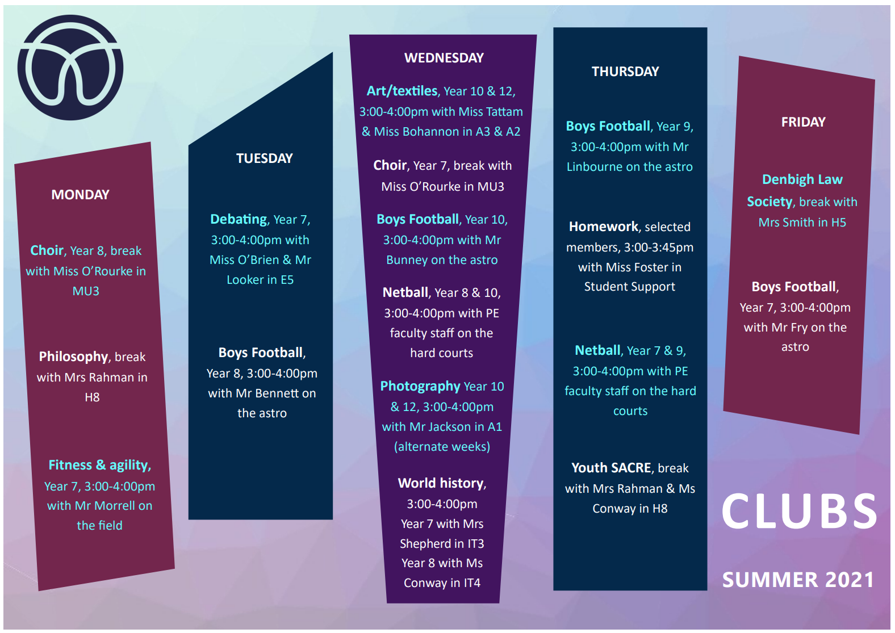
Clubs
For some of our students, this will be the first time that they get to attend a club!
In the coming weeks, a Clubs Timetable will be published that will include activities that take place in either break, lunch or after school
Please encourage students to come along to at least one
Notes:
Extra curricular activities are a good way for young people to get to know others with similar interests and spend more time doing what they love. These will include sporting, music, art and drama activities to name a few.
For some, this may be the first time they attend a club, so please do encourage students to get involved and try at least one.

Slide 29
Uniform, Phones and Conduct

Slide 30
Uniform
We believe that the wearing of correct uniform is important because:
It helps to instil a sense of pride and community in the school.
It creates a more positive school environment with fewer distractions.
It ensures that all students, from all backgrounds, feel comfortable and welcome.
It helps to protect students from the social pressures of dressing in a particular way.

Slide 31
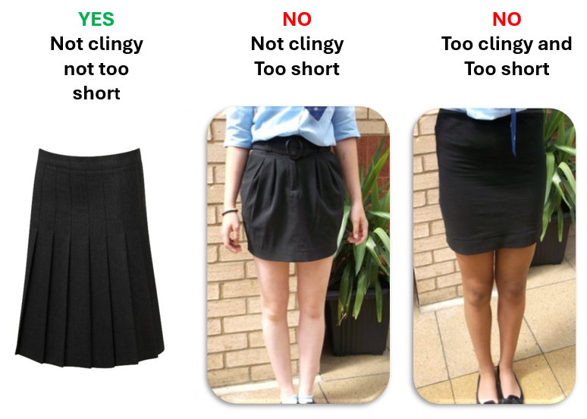

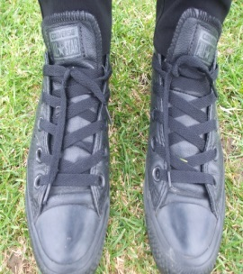
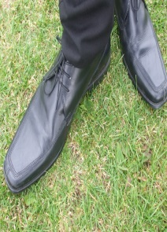
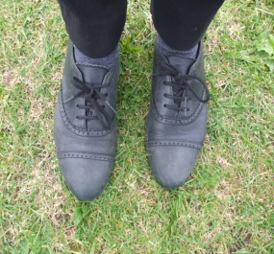
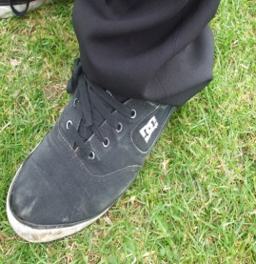

Uniform Examples
✓
X

Slide 32

Student conduct & Mobile phones
Core values of ‘be engaged, be kind and respectful and do no harm’.
Every student has the right to learn, every teacher has the right to teach
Behaviour ‘curriculum’
Rewards system.
Consequence system.
A range of internal sanctions.

Slide 33


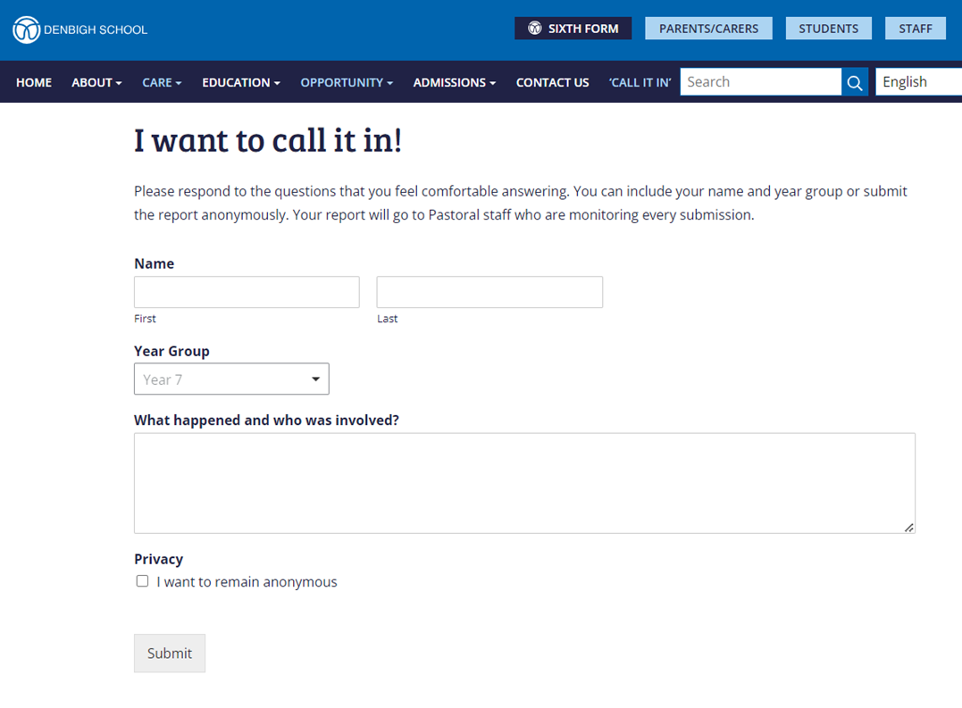



Slide 34
Assessment and Reporting
Notes:
PJE
Here at Denbigh we divide attitude to learning into 5 Attitude to Learning Statements. These statements are known as the 5 P’s.
The 5 P’s are to be Prepared, be Punctual, to Pay Attention, to Participate and to take Pride
Each strand will be graded out of 5 with 5 suggesting a student is exceptional within this strand and 1 suggesting that there is a cause for concern. Teachers will grade each strand and then provide a holistic Attitude to Learning grade which takes into account all of the strands.

Slide 35
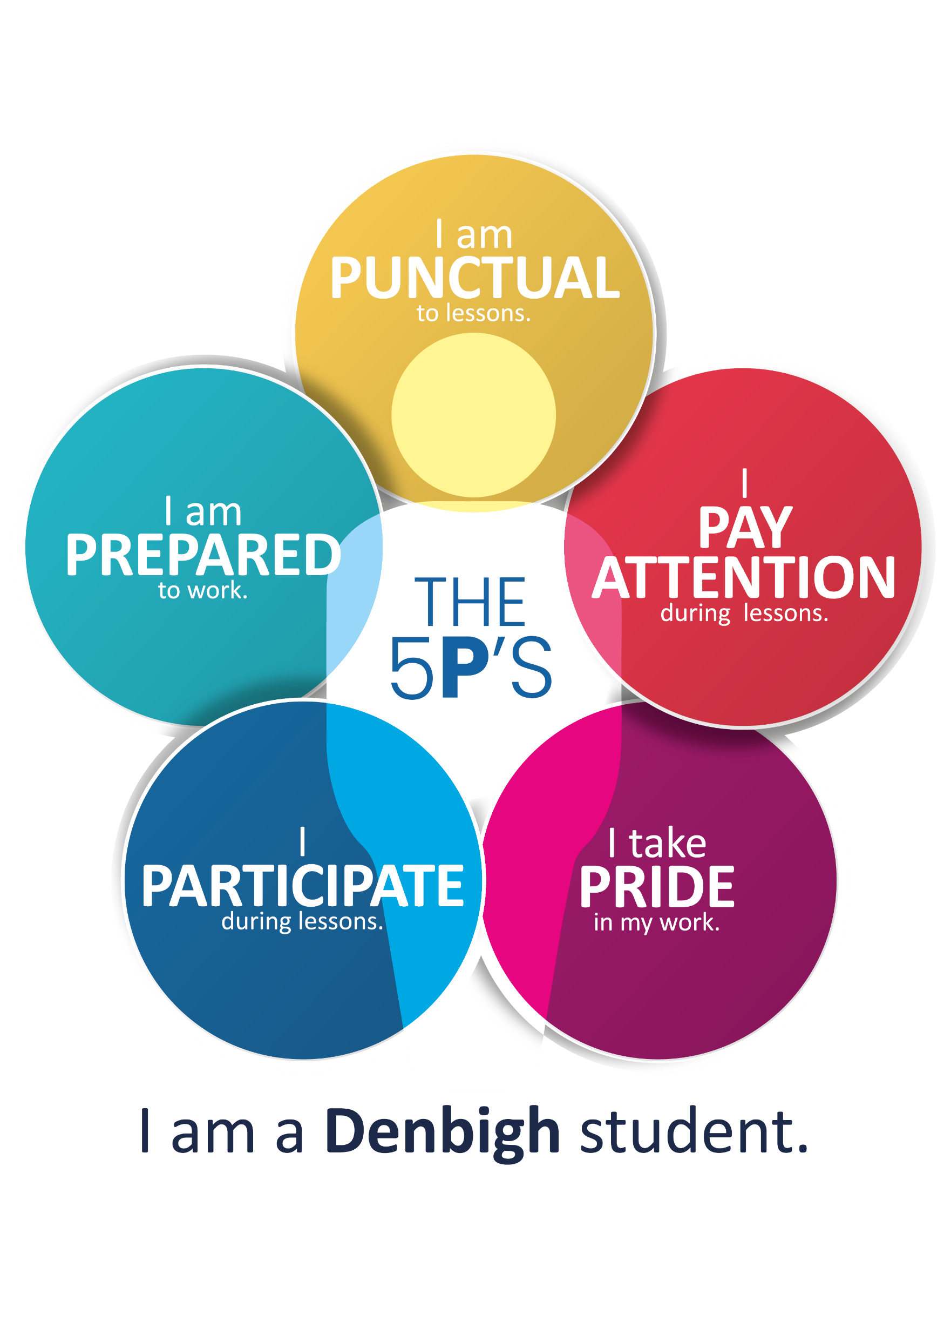
Attitude to Learning – 5Ps
The 5 P’s | Meaning
Prepared | I bring the correct equipment to lessons I complete my homework on time
Punctual | I arrive on time to my lessons
Pay Attention | I am attentive to the teacher and my peers’ contributions in class I am focused in lessons showing determination to challenge myself
Participate | I make positive verbal contributions in class I participate with enthusiasm in both group and independent tasks I reflect and act upon feedback I complete the work set to a good standard seeking help when needed
Pride | I take care with the presentation of my work and books
Notes:
This table provides some examples for each strand of the 5 P’s. This is not the full exhaustive list and are some typical examples that we would expect to see from a grade 3 ‘good’ student.

Slide 36
Progress Reports
At each Progress Report point, the teacher will report:
  Homework – Percentage
  Behaviour – the number of C points
  Attitude to Learning (5-1 scale)
  Achievement points
You will also receive attendance and punctuality data.
The teacher will also report a CLG (current learning grade) based on ‘Mastery Statements’
5. Exceptional
4. Very good
3. Good
2. Room for improvement
1. Cause for concern
Notes:
You will receive three progress reports through this academic year. The key dates each progress report can be viewed on the key dates slide at the end of the presentation.
At each progress report point your son or daughter’s teacher will report a Homework Percentage, the number of behaviour points and their holistic Attitude to Learning grade. For progress report 2 and 3, the teacher will also report a CLG (current learning grade).

Slide 37
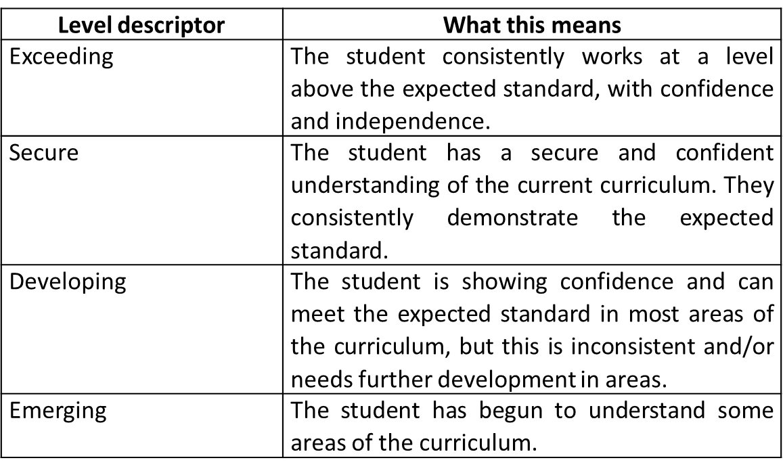
Assessment - Mastery
Each subject area has written statements for each subject indicating what students should know and have mastered by each reporting point (available on our website
Progress reports will provide a descriptor indicating how well students are achieving in line with these statements. There are four categories:
Notes:
Each subject area has written statements indicating what students should know and have mastered at key points throughout the year.
Teacgers will provide a level descriptor which indicates how students are performing in line with the subject statements.
There are four categories: exceeding, secure, developing and emerging.

Slide 38
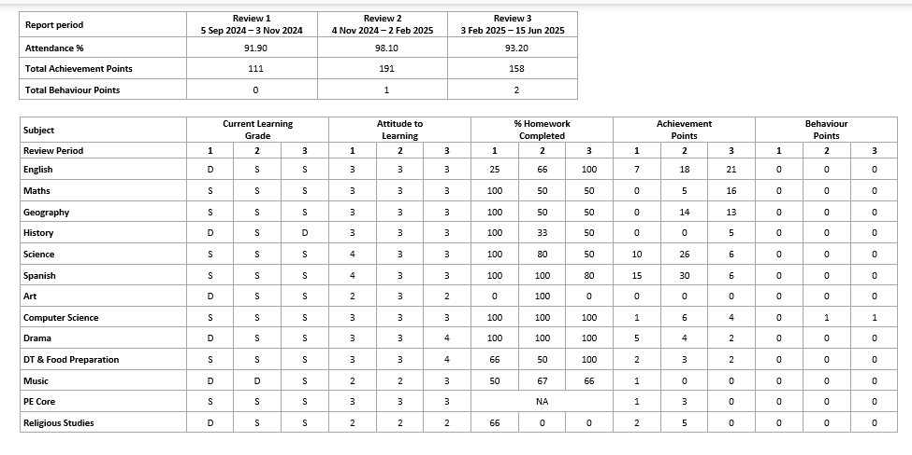
What it looks like
Notes:
You will receive three progress reports through this academic year. The key dates each progress report can be viewed on the key dates slide at the end of the presentation.
At each progress report point your son or daughter’s teacher will report a Homework Percentage, the number of behaviour points and their holistic Attitude to Learning grade. For progress report 2 and 3, the teacher will also report a CLG (current learning grade).

Slide 39
End of Year Assessments
Students will also complete end of year assessments each year to help gauge the progress within each subject overall
To be completed between 11th-17th May
Students will complete these in classrooms in years 7 and 8
Can expect to complete every year in the lead up to GCSEs
Notes:
The end of year assessments are a series of assessments completed for each student, every year, to gauge their progress within each subject.
Students will complete their assessments in classrooms during xxxxx

Slide 40
How to support at home
“What can we do to support at home?”
Reinforcing good routines
Attending our tutor and subject consultation evenings
Helping Year 7 prepare for their end-of-year assessments
Support students with the core subjects of Maths and English
Schemes of Learning can be found on our website under Education-Faculties
Encourage extra-curricular clubs
Notes:
“What can we do as parents to support at home?” is a question that we get asked often by parents.
The key areas that we encourage parents to focus on include:
Reinforcing good routines at home with homework, organisation, and attitudes to learning.
Ensuring attendance to our tutor and subject consultation evenings so that you can receive the most up to date information on your son or daughters academic progress
Providing help to your son or daughter with their preparations for their end of year Pre-Public Exams
And finally, support them as much as possible with the core subjects of Maths and English.

Slide 41
Date | Event
11/09/25 | School Photos
01/10/25 | 13:30-17:30 Tutor Consultation (Early finish for students 12:40)
21/10/25 | Enrichment Day
24/11/25 | Progress Report 1
05/12/25 | Charity Day and Christmas Bazaar
18/12/25 | School closes to students at 12:40
02/03/26 | Progress Report 2
13/03/26 | Charity Day
26/03/26 | Enrichment Day
11-15/05/26 | End of year assessments
03/06/26 | Year 7 Subject Consultation Evening
06/07/26 | Progress Report 3
10/07/26 | Enrichment Day
13/07/26 | 13:30-17:30 Tutor Consultation (Early finish for students 12:40)
17/07/26 | School closes to students at 12:40
Key Dates
Notes:
On this slide, you can see some of our key dates for this year.
ERE

Slide 42
Miss Pickard

Slide 43
Enrichment Days
Enrichment days are designed to present the opportunity for students to learn in environments outside of the ‘normal’ classroom and enable students to create lifelong memories.

Slide 44
Enrichment Days
You will receive a letter asking for a payment of £65 on Parentmail. This pays for the year and can be paid in instalments.
Pupil Premium students will be paid for by the school.
You will need to complete a medical/consent form for each of the external trips. This has to be repeated before each trip to ensure information is up to date.
Any delays to responding to the payment or medical forms does significantly slow down the administration of the process.
If you miss the deadline we cannot guarantee your child a place on an external trip.

Slide 45



Year 7 Enrichment
 | 7
 | X | Y | Z
Autumn Tuesday 21st October | Warwick | Woburn | Junior Apprentice
Spring Thursday 26th March | Junior Apprentice | Warwick | Woburn
Summer Friday 10th July | Woburn | Junior Apprentice | Warwick
£65

Slide 46
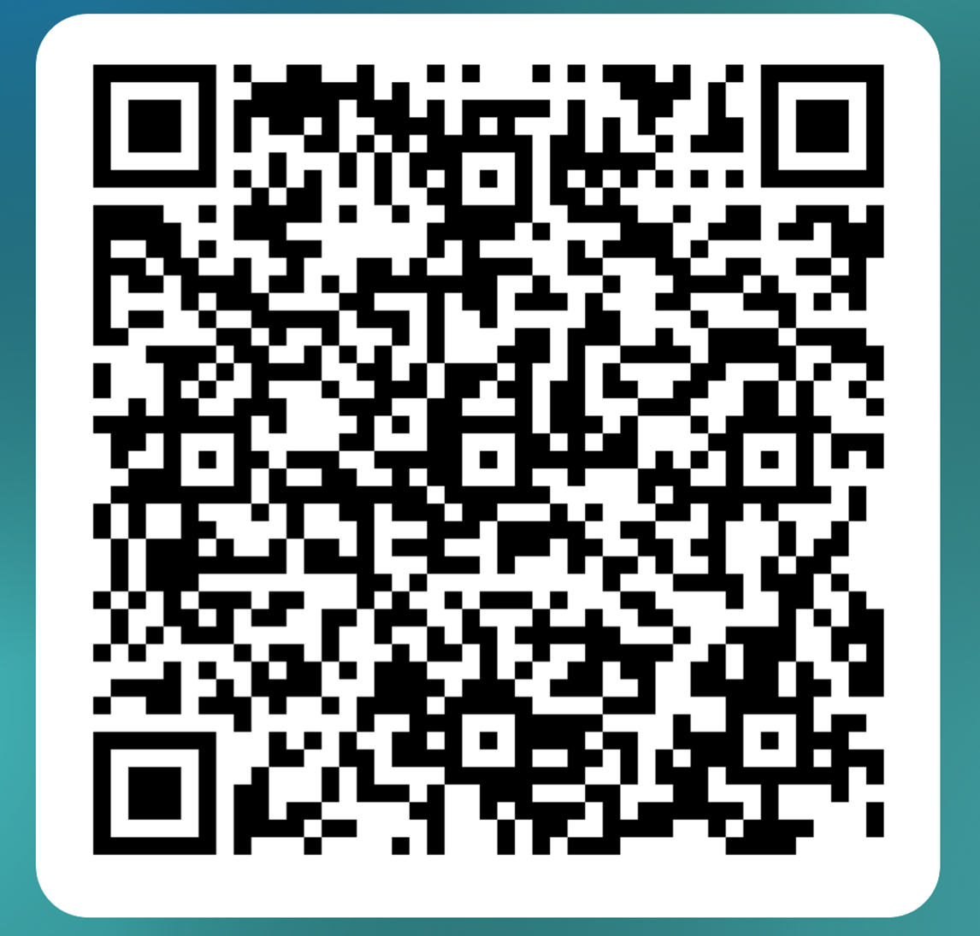
Please use the QR Code to log your attendance and provide feedback on the evening.
Notes:
Do pop into the activity studio as you leave to find out more about the association. I will now hand over to Miss Ings who is head of Stephenson house and she will talk about pastoral support and how we’re promoting literacy

Slide 47
Thank you for listening
Notes:
That concludes this evening’s curriculum pathways evening, and I hope that you have found the information that we have provided useful.
Thank you for listening.

