Slide 1

Think Denbigh
Making the Most of Year 11
September 2026
Presented by:
Miss Dolling (Progress) &
Miss South (Pastoral)
Heads of Year

Slide 2
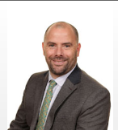
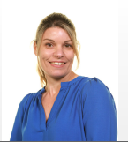

Welcome Back
Your team
Mr Burgess – Assistant Headteacher for Yr 11 Progress burgessj@denbigh.net
Miss Dolling– Head of Year (Progress) dollingl@denbigh.net
Miss South– Head of Year (Pastoral) southc@denbigh.net
Presentation Title

Slide 3
Outline of the Evening
Reminders (support in school, values and uniform)
Targets and Setting
Curriculum Information
Revision
Attendance and Punctuality
Attitude to Learning
Planners and Homework
Work Experience
Key Dates
Study Leave

Slide 4
Support in School
If you feel your child needs support, you can contact your child’s tutor or pastoral HOY.
Miss South: southc@denbigh.net
Tutor Group | Tutor | Email address
1ML | Jo Saunders / GES | saundersj@denbigh.net spittleg@denbigh.net
1QB | Matt Linbourne | linbournem@denbigh.net
1JL | Quentin Berriman/ SHI | berrimanq@denbigh.net
1JB | Jonard Lee | leejo@denbigh.net
1IA | Jo Booth (was 0IR) | boothj@denbigh.net
1UA | Maria Aleman | alemanm@denbigh.net
1SD | Usman Aftab | aftabu@denbigh.net
1JV | Sieraj Dean (replaces EAK) | deans@denbigh.net
1JW | Javis Vassell | vassellj@denbigh.net
1ML | Joseph Wu | wujo@denbigh.net
Contact details

Slide 5
Form Tutors are…
The first point of Call
An advocate in school
A mentor
Support for anxiety and stress
Help to develop motivation
Support in looking at goals and career pathways
Support in planning and organisation
Sharers of a variety of revision techniques
Behaviour managers - Tutor Report
The Tutor’s Role

Slide 6


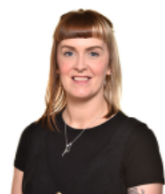
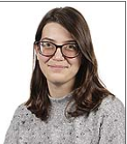
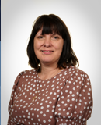
Support in School – Pastoral
Mrs Rose
Behaviour Mentor
Inappropriate language, unkindness and bullying, disruption and defiance, REACH.
Mr Fisher
Counsellor
Significant Mental Health concerns.
Miss Anderson
Counsellor
Mrs Conway
LGBQT+ Ambassador
Support around orientation or gender.
Mrs Boddy
Pastoral Mentor
Social/friendship issues, low mood, anxiety, self-esteem, managing emotions, Art for Wellbeing, Protective behaviours.

Slide 7

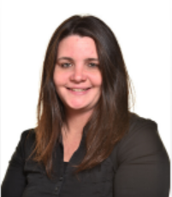
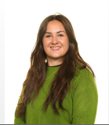
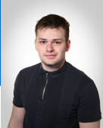
Support in School – SEND
Mrs Church
SEND administrator
Mrs Martin
SENDCo
Mr Georgiou
Deputy SENDCo
Miss Morrison
HLTA
Sendco@denbigh.net
The SEND Team

Slide 8
Support in School - Interventions
Drug and Alcohol support from MK Council
Information sessions and counselling where appropriate
Headspace with Mark Little
  Targeted pastoral mentoring
Service Six
Counselling (short term) for students in need of additional support
MHST
  NHS mental health support team (counselling)

Slide 9



Our Core Values
These all contribute to students making the most progress in their education.
We want to hold students accountable for their learning, and for allowing and supporting the learning of their peers.
Our Values

Slide 10

Uniform
We believe that the wearing of correct uniform is important because:
It helps to instil a sense of pride and community in the school
It creates a more positive school environment with fewer distractions
It ensures that all students, from all backgrounds, feel comfortable and welcome
It helps to protect students from the social pressures of dressing in a particular way

Slide 11

Call-it-in

Slide 12
What behaviours should we ‘Call in’?
‘Bullying is the repetitive, intentional hurting of one person or group by another person or group, where the relationship involves an imbalance of power. Bullying can be physical, verbal or psychological. It can happen face-to-face or on-line’. Anti-Bullying Alliance definition of bullying adopted by all MK secondary schools
Misogyny is hatred or prejudice against women or girls. It is a form of sexism that can keep women/girls at a lower status. It can be understood by the attitude held by men/boys around women/girls.
Racism is the belief that some races are better than others, or the unfair treatment of someone because of his or her race
Discrimination is the unjust or prejudicial treatment of different categories of people, especially on the grounds of ethnicity, age, sex, or disability:

Slide 13
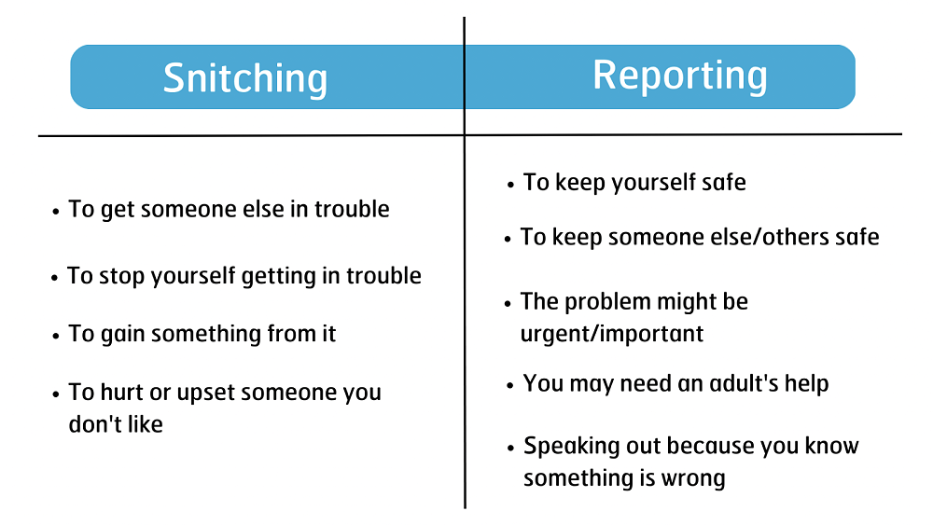
Dispelling the ‘Snitch Culture’
Notes:
I want to take a moment to address an important topic that affects not only our school community but also society at large—snitching.
The term “snitching” often carries a negative connotation, but it’s important to take a step back and reflect on what it truly means. At its core, “snitching” refers to informing on someone, typically about actions that are harmful or unlawful. The idea of snitching is often seen as betraying loyalty, but I urge you to think about the broader context.
There’s a difference between protecting others and standing by while harmful actions go unchecked. If you witness bullying, cheating, violence, or any form of injustice, it's not about being a "snitch"—it's about doing the right thing. Sometimes, speaking up is the only way to protect someone from harm or to prevent further damage. True loyalty to our community means creating an environment where everyone feels safe and valued.
It’s understandable that peer pressure or fear of judgment may lead to hesitation, but remember that your actions have the power to shape the culture around you. Be the person who stands up for what’s right, not just for what’s easy. You’re never alone in seeking help or guidance—teachers, counsellors, and administrators are here to support you.
Let’s challenge the notion of “snitching” and shift towards a culture of responsibility, care, and accountability. Your voice matters, and by using it for good, you can make a positive difference.

Slide 14
How can you CALL IT IN?
‘CALL IT IN’ Ambassador
Online via the school website
Tell a Trusted Adult (tutor/teacher/HOY)
Notes:
Appropriate use of online call it in

Slide 15
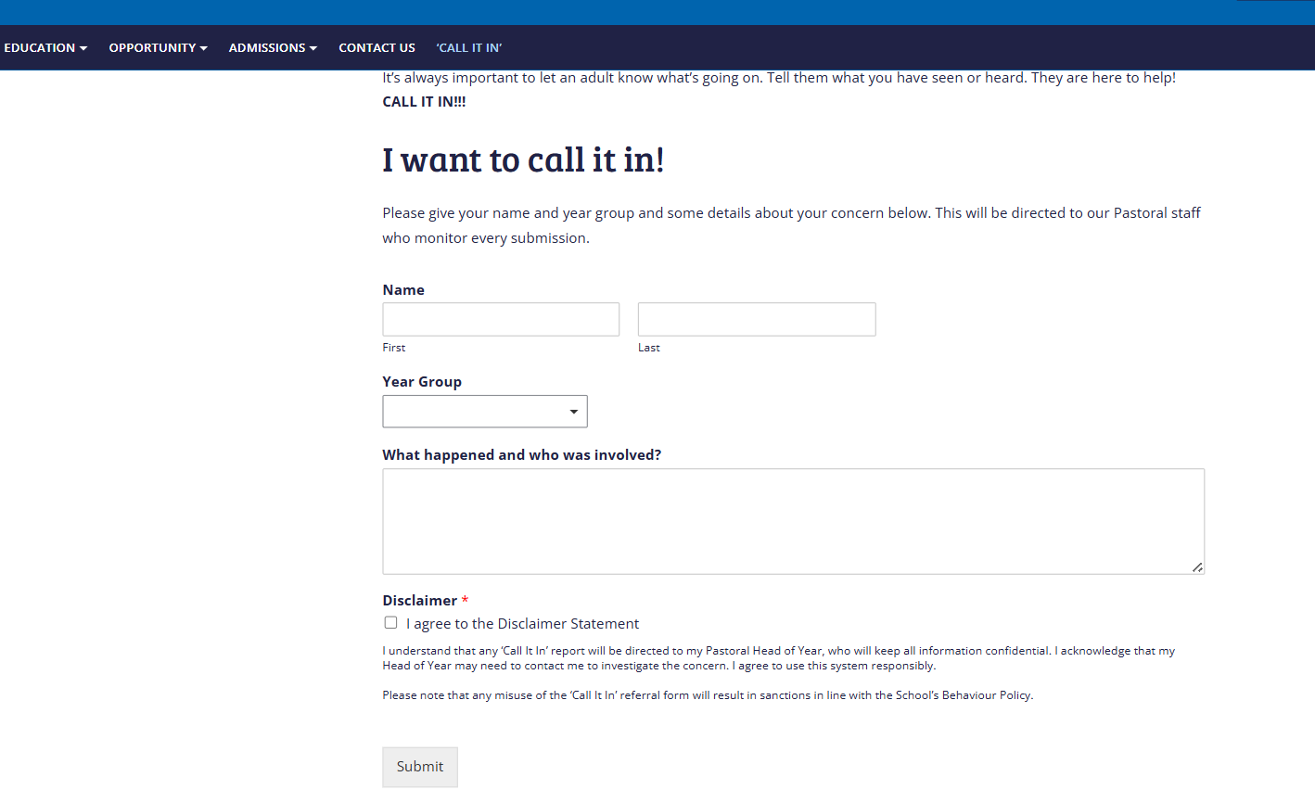
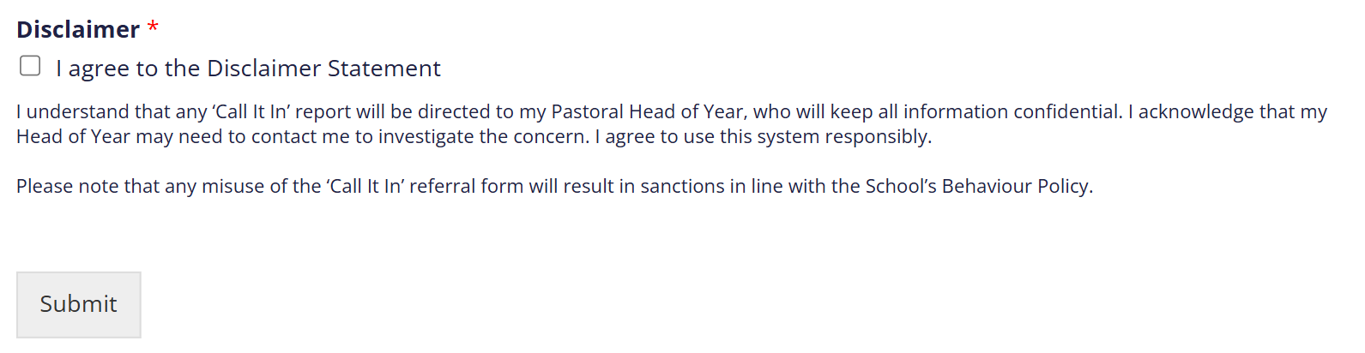
How do I ‘Call It In’?
Website Update
Anonymous tab has been removed
Must agree and read Disclaimer before submitting the report
'Call it in' - Denbigh School - Milton Keynes

Slide 16
Progress: targets, setting and staying calm about exams

Slide 17
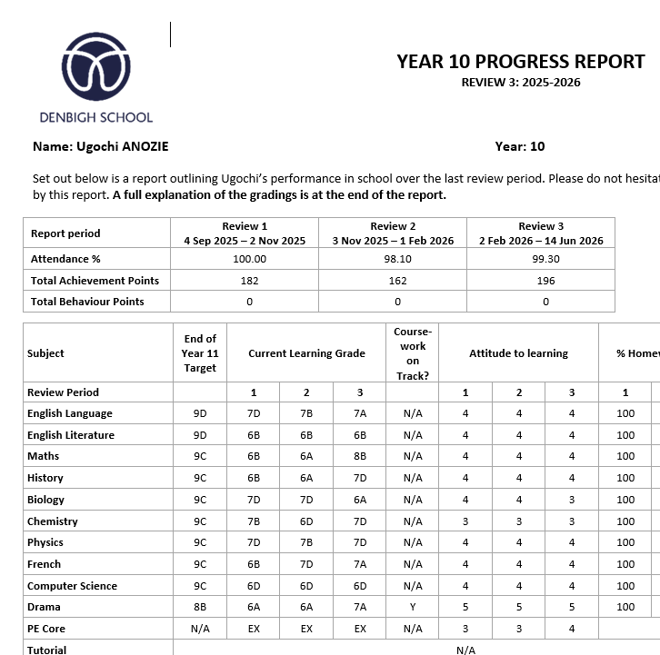
Progress Report 3
All students have got end of Year 11 targets, which are aspirational targets.
The Progress Report 3 is the best place to review their progress towards that target.
Here you can identify the areas to prioritise for revision.
This also helps us to plan for intervention and support for individual students so that it happens at the right time and makes a difference to their academic progress

Slide 18
How do we set targets for GCSE?
The best indicator of future success is prior attainment
Fischer Family Trust (FFT) National database - Progress made by similar pupils nationally between Year 6 and Year 11
Considers gender and month of birth
This forms the basis of our target grades

Slide 19
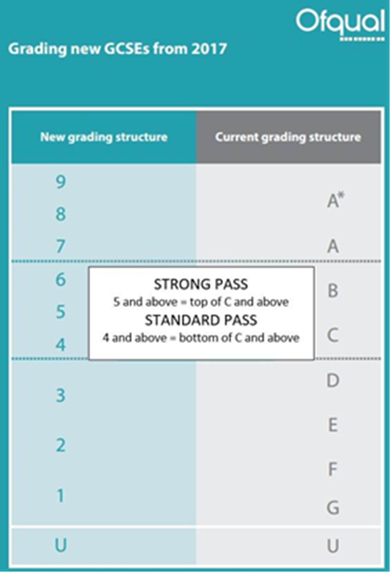
GCSE grading
Since its introduction in 2017 GCSE qualifications now use a numerical grading system instead of the familiar A*-G grades
Within each subject students will receive a grade 9-1

Slide 20
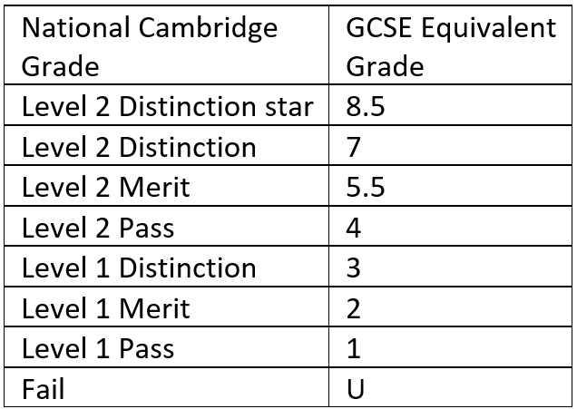
Cambridge Nationals
Students taking the following qualifications will be graded using a Distinction* to Pass system
Enterprise & Marketing
Health & Social Care
Information Technology
Health & Fitness
Child Development

Slide 21
Curriculum
How to support your children at home

Slide 22
English, Maths and Science Setting
Students will continue in their Science sets as they were at the end of Year 10.
In English and Maths they remain in their two bands (C&D) and will remain in their sets 1 through to 5 on each side in most cases retaining their Year 10 teacher.
Consistent approach for all and a best fit approach is taken
Sets will continue to be reviewed periodically across the year
Final decisions on tiering to be made after PPEs in Year 11
No tiering in English – all can achieve a Grade 9

Slide 23
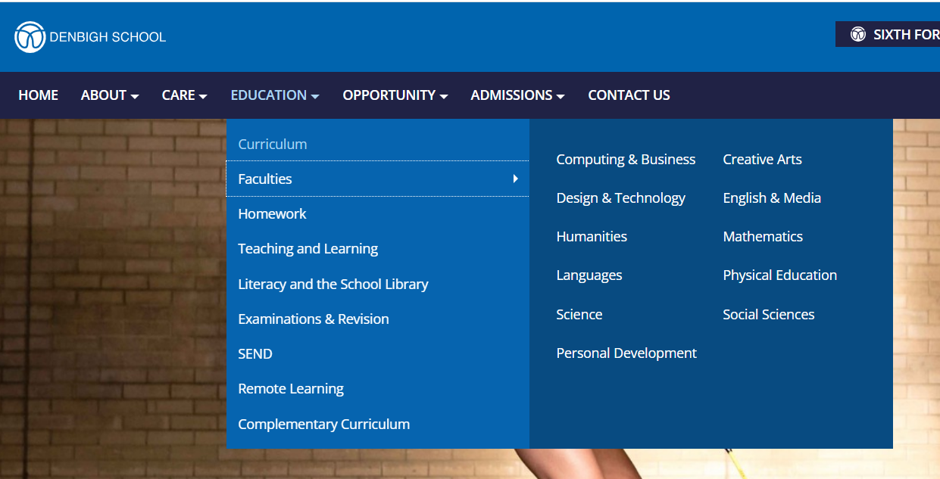
Schemes of Learning can be found on our website under Education-Faculties

Slide 24
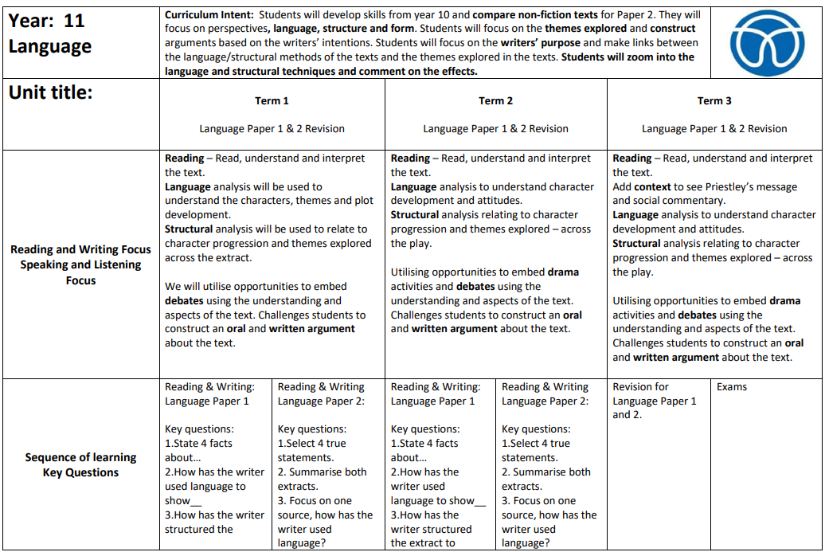
Scheme of Learning – Year 11

Slide 25
Coursework
Managing deadlines

Slide 26
Coursework Deadlines
GCSEs are typically assessed with a final exam, but our Cambridge courses are up to 60% coursework.
Keeping on top of coursework deadlines is absolutely essential and your support with this will be crucial.
The whole school NEA deadline is March 25th, however individual subjects may have earlier deadlines. Faculty leaders will communicate these through the year.
Deadlines

Slide 27
Revision
Getting into good habits

Slide 28
In-school Revision Sessions
Revision sessions
Speak to subject teacher in first instance
Parents to support with ensuring child attends
Some compulsory targeted sessions
Some are voluntary
Comms will come via faculty leaders via parentmail

Slide 29
Revision
What? | Why?
Deciding what you need to know | Identifying the knowledge you need to memorise
Memorising | Storing the knowledge in your long term memory
Practising/ Testing | Retrieving the knowledge from your long term memory so you remember more

Slide 30
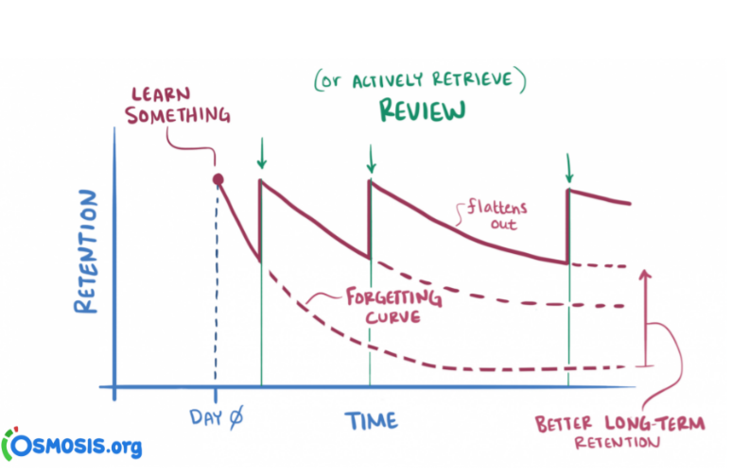
Active vs. Passive Revision
Actively revising helps us retain what we have learned.
Re-reading notes, highlighting or copying chunks of text is not as effective as you might think – this is passive revision.
Research demonstrated that passive methods do not lend themselves to retention.
To actively engage, is to actively retain. So we think about the material differently and make links, so you draw on a range of information in an unseen exam setting.
There is an argument that we remember:
20% of what we read
30% of what we hear
40% of that we see
50% of what we say
60% of what we do
90% of what we read, hear, see, say and do
This may not be scientific , but for most people, coding information in a multitude of ways aids retention.

Slide 31
Revision Top Tips for Parents & Students
Create the right conditions for learning: Children remember more when they are well-rested, comfortable, free from distractions, and have enough time and motivation to focus.
Short, regular study sessions work best: Revising little and often is much more effective than trying to learn everything in one long session.
Take regular breaks: Memory and concentration decline over time, so a 5–10 minute break every hour helps children stay focused and retain more information.
Plan revision over time: Encourage children to revisit topics repeatedly across days and weeks, rather than cramming everything into one evening.
Use spaced repetition: Reviewing information just as it is starting to be forgotten strengthens long-term memory and makes recall easier in exams.
Practice remembering, not just rereading: Asking children to recall information from memory (through quizzes, flashcards or explaining it aloud) helps build stronger, longer-lasting learning.

Slide 32
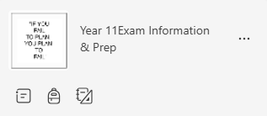
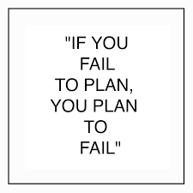

Revision
Little and often!
Build resources to last
Break up subjects and topics – Create a timetable – Year 11 Exam Information & Prep Page has lots of useful templates
Be specific with exactly is to be achieved
Be realistic - how much and when?
Who can help hold you to account?
Choose the correct environment – Home? Library?

Slide 33
Attitude to Learning

Slide 34

Attitude to Learning – 5 P’s
5. Exceptional
4. Very good
3. Good
2. Room for improvement
1. Cause for concern

Slide 35
Attitude to Learning – 5Ps
The 5 P’s | Meaning
Prepared | I bring the correct equipment to lessons I complete my homework on time
Punctual | I arrive on time to my lessons
Pay Attention | I am attentive to the teacher and my peers’ contributions in class I am focused in lessons showing determination to challenge myself
Participate | I make positive verbal contributions in class I participate with enthusiasm in both group and independent tasks I reflect and act upon feedback I complete the work set to a good standard seeking help when needed
Pride | I take care with the presentation of my work and books

Slide 36
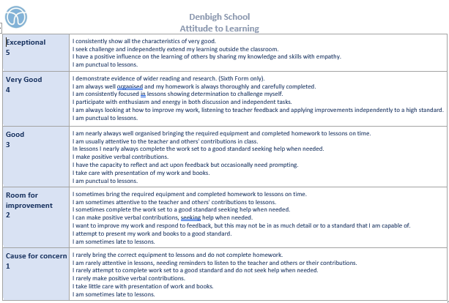
ATL Grid

Slide 37
Managing stress
Looking after yourself and getting organised!

Slide 38
Healthy Mind and Body
As well as revision and keeping on top of homework it is important for students to make time for themselves.
Some examples:
Be physically active
Meditation
Yoga
Mindfulness techniques
Self-reflection

Slide 39
Getting organised
All students received a planner at the start of the academic year.
Some keys areas of the planner are:
Revision timetable template
Revision tips
Wellbeing tips/ strategies
Tips to develop mental toughness, listening skills and being able to ask for help
Planning time effectively
Understanding digital wellbeing
Healthy relationships
Helpful telephone numbers/contacts
Goal setting
To do lists

Slide 40
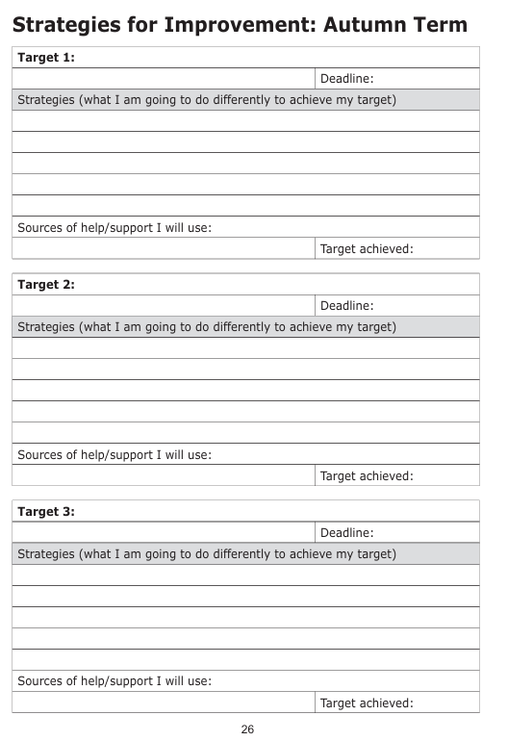
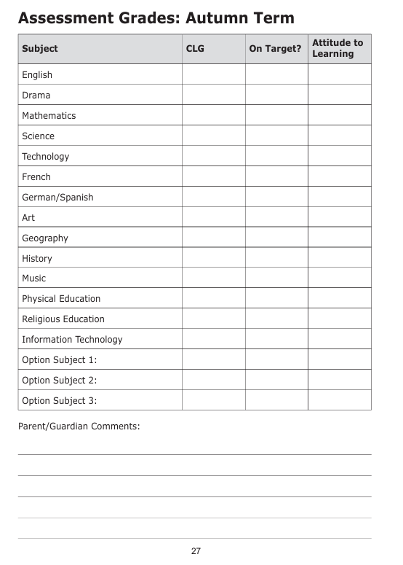
Termly Assessment Grades
A dedicated tutorial session for reviewing of CLGs after each Progress Report.
Students encouraged to record and reflect on progress so far
This can then be recorded in their planners each term

Slide 41

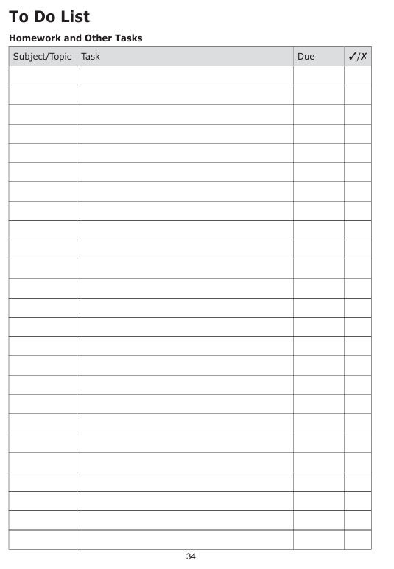




Homework
Teachers will place homework tasks on Microsoft Teams.
There are a variety of platforms on which homework is set including:
Educake
Sparxs
Memorize
Seneca
Student planners also have a Weekly To-Do list – students could use this to help organise their weekly homework
Parents can have an overview of homework by installing Teams on your phone or tablet and have your child login into their account.

Slide 42
Punctuality & Attendance

Slide 43
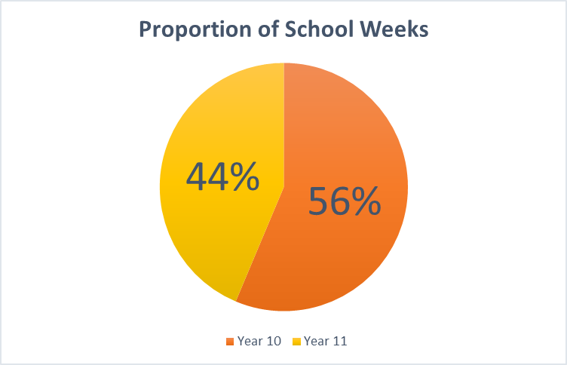
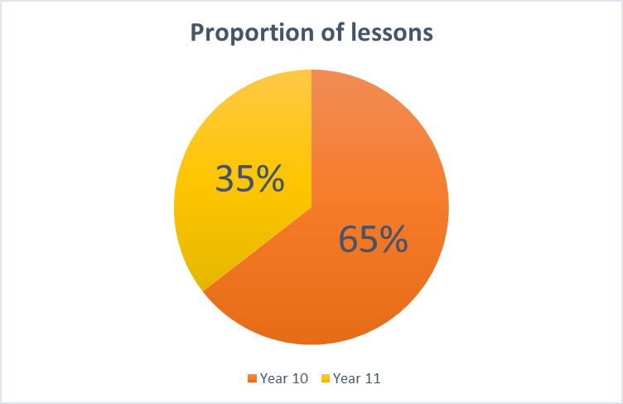
Year 11 is a shorter year

Slide 44
Punctuality
Being just a few minutes late to lessons on a regular basis can have a big effect on learning:
3 mins late to 1 lesson per week = 117 mins
(nearly 2 missed lessons in a school year)
3 mins late to 1 lesson per day = 585 mins
(nearly 10 missed lessons or 2 school days in a school year)
3 mins late to every lesson every day = 2,925 mins
(around 49 missed lessons or 10 school days in a school year)
Research suggests that 17 days missed from school equates to achievement being lowered by a FULL GCSE grade.

Slide 45

Attendance
Directly linked to performance
Target of 95+% Attendance for all students
P E R F O R M A N C E
A T T E N D A N C E

Slide 46
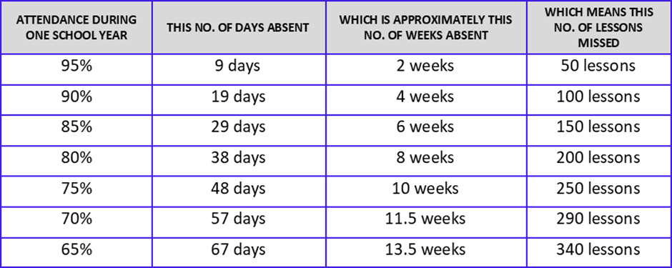
Attendance

Slide 47
Denbigh Careers information
Students follow a careers programme within PSHE lessons and through Faculties.
This is based around three strands of a skills and knowledge curriculum
All students have received a log in for UNIFROG, and will use this programme to track their career journey
Another excellent free careers website to encourage your child to explore is: https://www.startprofile.com/
How can you help?
Discuss careers with your son/ daughter
Explore UNIFROG and look at the different career options and pathways available and encourage your child to record any career related activity on to UNIFROG

Slide 48
Enrichment

Slide 49
Enrichment Days
Two days Tuesday 20th October and Wednesday March 24th
Both in school, likely start time of 9am finishing at 3pm (TBC)
Details to be finalised and will be sent out via Parentmail in due course

Slide 50


Enrichment at Denbigh
We have a large range of opportunities for students to get involved in at Denbigh School – these can be a great addition alongside student studies
Clubs – before, during and after school
School trips
House and School council involvement
House competitions
Sporting teams
Leadership opportunities
DofE

Slide 51
Year 11 Key Dates

Slide 52
Year 11 - Key Dates
Date | Event
17th September | Maths Progress Test
23rd September | English Progress Test
30th September | Tutor Consultation Afternoon
19th October | Year 11 Progress Reports Home
20th October | Enrichment Day
23rd October | Year 11 Futures Day
4th November | Year 11 Subject Consultation Evening
18th November | English PPE – Language Paper 2
Monday 23rd November – Tuesday 8th December | Year 11 PPEs
10th December | A Christmas Carol Performance
13th January | Sixth Form Open Evening

Slide 53
Year 11 - Key Dates
Date | Event
Monday 18th January | Year Group Photo
Wednesday 20th January | Year 11 English Progress Test
Thursday 21st January | Year 11 Maths Progress Test
Monday 25th January | Year 11 Progress Reports to Parents
Wednesday 27th January | Year 11 Parent Consultation Evening
Thursday 11th February | Year 11 Leadership Interviews
Thursday 25th February | Year 11 Maths PPE – Paper 1
Friday 26th February | Sixth Form Application Deadline
Wednesday 3rd March | English PPE – TBC
Thursday 4th March | Maths PPE – Paper 2
Wednesday 10th March | Maths PPE – Paper 3
Wednesday 24th March | Enrichment Day
Thursday 25th March | Progress Reports home to Parents
Monday 10th May | GCSEs begin

Slide 54

In School Assessments through the year

Slide 55
Collapsed Timetable and Study Leave

Slide 56
Study Leave
Leavers assembly will be on [Date TBC]
Students will not officially be on Study Leave until after the May half term.
Between the Leavers assembly and May half term is referred to as a collapsed timetable. Students will be following their timetable. However:
  Some faculties will run targeted revision sessions
  If the students have finished that subject, they will be allowed to revise other subjects
After half term, when study leave starts, there will be compulsory revision sessions for some/all student to attend. However:
  Students will be allowed to come into school to revise
  The students must be arriving in school 15 minutes before the exam starts to give themselves time to sign in, get to the room and be seated at the start of the exam

Slide 57
All working together
Parents
Teachers
Tutor
Student
Progress Leader
Pastoral Leader

Slide 58
Thank you for listening!
September 2025
Presented by:
Miss Dolling and Miss South – Heads of Year

